Slide 1

Introduction to Selenium

Slide 2
Introduction to Selenium
Selenium is a automation test suite(collection of tools) that supports rapid development of test automation for web-based applications.
It is a open source tool(free of cost)
Selenium provides a rich set of testing functions specifically that fulfil the needs of testing of a web application.
Selenium operations are highly flexible as compared to other tools

Slide 3
Components of Selenium
Selenium has four components:
Selenium Integrated Development Environment (IDE)
Selenium Remote Control
Webdriver
Selenium Grid

Slide 4
Selenium IDE
It is the simplest framework among all Selenium tools.
It is implemented as a Firefox extension.
Used to record, edit, and replay the scripts in firefox
Selenium IDE allows you to save tests as HTML, Java, Ruby scripts, or any other format
It allows you to automatically add assertions to all the pages.

Slide 5
Selenium IDE Installation
Open Firefox and navigate to https://addons.mozilla.org/en-US/firefox/addon/selenium-ide/.
Click on Add to Firefox
Click on Install after completion of installation
Launch the Selenium IDE after restarting Firefox.
Click on firefox menu→Web developers→Selenium IDE to launch it.

Slide 6
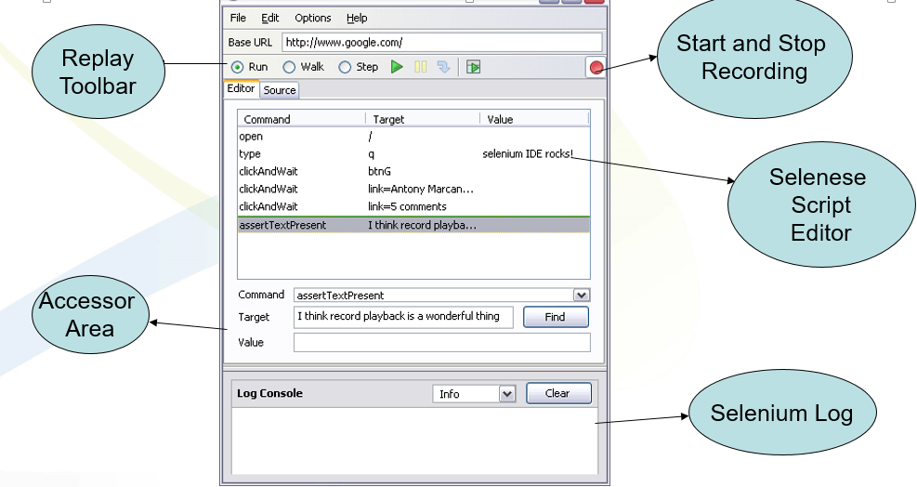
Selenium IDE UI

Slide 7
First Selenium Script
Open Firefox with installed Selenium IDE
Navigate to the URL of the application for scripting.
Toggle the Record button ‘ON’
Now perform the operations on the application as you are testing the application.
After completing the recording ,click on the stop recording button and save the test case. By default it will be saved in HTML format.

Slide 8
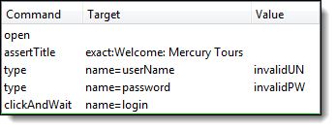
Script-1(Your script will look like)

Slide 9
Commands
Open-Opens the specified URL
click or clickAndWait- Clicks on a desired element.
verifyTitle/assertTitle- Compares the actual page title with an expected value.
waitForPageToLoad- Pauses execution until the page is loaded completely.
Select- selecting options from a drop-down listbox
Type-to enter the values

Slide 10
Run the Selenium Script
Make sure the application is in the common base state.
Click on the run button. Here you can also control the speed of the execution using the toolbar
Once the test is run you can view the test log in the bottom of the IDE window

Slide 11
Test Suite Creation
Test suite is a collection if multiple test cases.
Selenium IDE allows the user to run multiple test at one go.
To Run the test Suite click on the “Play entire test suite” button

Slide 12
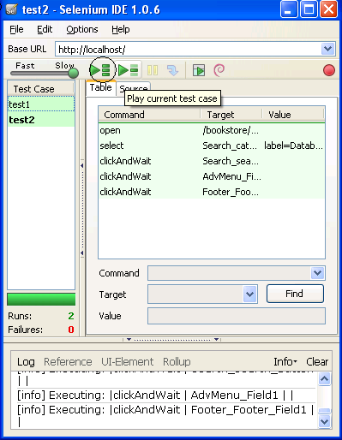
Running a Suite
Test Suite with
Test1 & test2

Slide 13
Assertions
Assertions are common part of testing
They are used to check if
an element is present somewhere on the page?
specific text is somewhere on the page?
specific text is at a specific location on the page?
There are multiple assertions to perform verification and validation

Slide 14
Adding Assertions
Assertions are used if the assertions fail,the script will abort. But the script will continue run in case a verification point fails.
The steps for inserting the assertions are as follows:
While recording Right Click → Show all commands → select an assertion

Slide 15
Assertion Commands
assertTextPresent
This will assert if the text is present in the page.
assertText
This will assert if a particular element is having the particular text.
assertTitle
This will assert if the page is having a proper title.
assertValue
This will assert if a Text box or check box has a particular value
assertElementPresent
This will assert if a particular UI Element is present in the page

Slide 16
Verification Commands
verifyTextPresent
This command is used to check if a particular text is present in a page or not.
To add this command , While recording the test steps right click on the text item that you want verify. Once right clicked you can find an option “Show all commands”. On Clicking it you will find an option “verifyTextPresent”, select it.

Slide 17
Verification Commands-2
verifyValue
This method is used to check if edit box has particular value or if the check box is on. Basically this method returns the value of present in the object.
To add this command , While recording the test steps right click any element on the page that you want verify the value of. Once right clicked you can find an option “Show all commands”. On Clicking it you will find an option “verifyValue”, select it.

Slide 18
Verification Commands-3
verifyElementPresent
This command is used to verify if a page element is present in the page or not.
To add this command , While recording the test steps right click any element on the page that you want verify. Once right clicked you can find an option “Show all commands”. On Clicking it you will find an option “verifyElementPresent”, select it

Slide 19
Wait Commands
waitForPageToLoad- make the script to wait till the page loads.
waitForAlert-wait for the alert message to appear
waitForTitle- will for the page Title to appear on the browser.
waitForTable-wait for the Web table to completely load in the page

Slide 20
Handling Store Commands
Used to fetch the values from the application and store it in a variable.
These variables can be used latter for validation purpose.
Used to retrieve the page title, text from the page and other attributes from the application

Slide 21
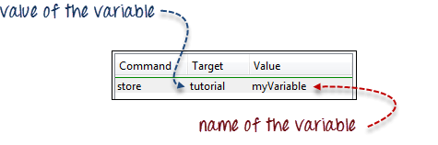
Store Command Example
1

Slide 22
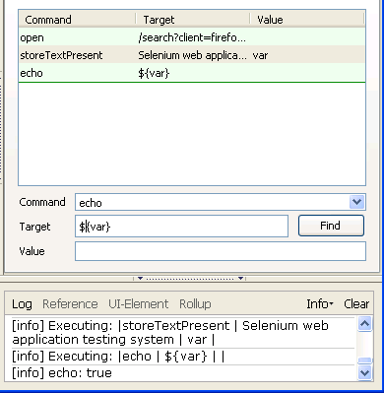
Echo Commands
Echo command is used to print the value in to the selenium IDS log.
When printing a variable use ${var}

Slide 23
Drawbacks of Selenium IDE
Runs only on firefox
Loops, conditional statements can not be applied
Can not handle dynamic content like dynamic tables
Doesn't support error handling
Selenium IDE do not support Database testing

Slide 24
Thanks

